Slide 1
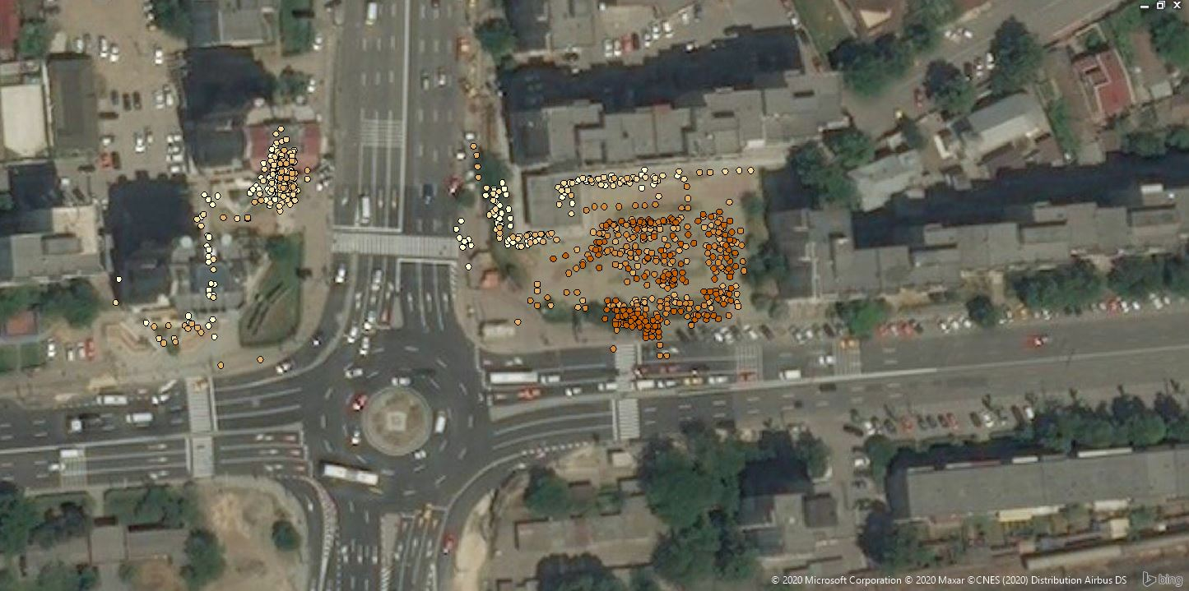
Anexa 2 - Suggestions TUD: survey areas
Area 1
Area 3
Area 2

